Slide 1
Scenarios
Id
Computer_id
User
Password
Session_time
Inner_scenario_id
Count
Computers
Id
Host
Host_password
Port
OS
Description
Inner_scenarios
Id
Host
User
Password
Session_time

Slide 2
Testbed environment
VNC
Client computer
RDP
Wiki server
Client computer
Simulator
Database
Client computer
Domain controller
Client computer
VNC port
ESXi

Slide 3
logon_hotkey
C1
C2
C4
logon_user
C3
C7
desktop
C5
C6
rdp_success

Slide 4
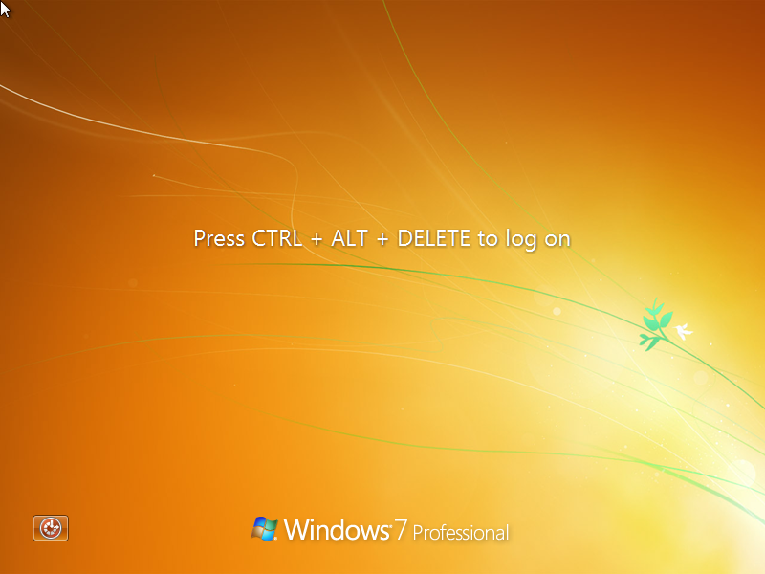
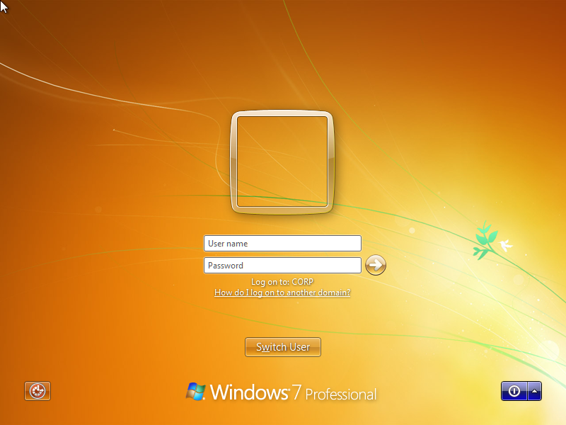
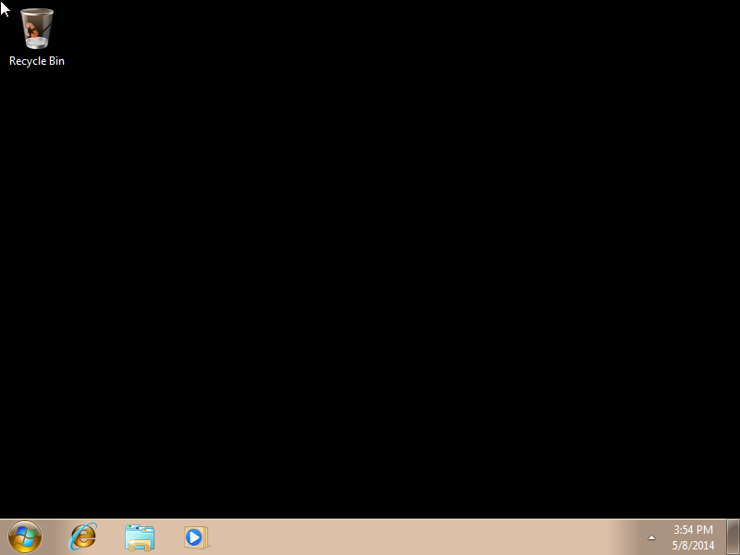
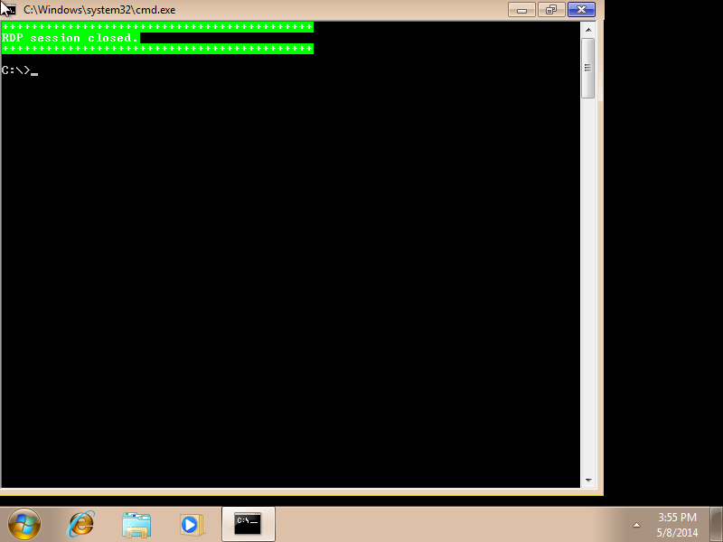
logon_hotkey
logon_user
desktop
rdp_success

